Slide 1
Placement Prediction System using various Machine Learning techniques
By-
3302. Anand Kumar Sinha
3165. Sangat Das
3161. Rohit Barde
3307. Ashish Daulatabad

Slide 2
Contents
Introduction
Motivation
Problem Definition and Scope
Different Machine Learning Algorithms
Methodology
Results and Implementation
Future scope
Conclusion
References

Slide 3
Introduction
What is Placement Prediction System?
Why do we need it?
Who is going to use it?
How to make it?

Slide 4
Motivation
Competitive Environment
Placement Uncertainty
Peer Pressure
Lack of relevant skills
Lack of required training activities
Need to know where do students stand.

Slide 5
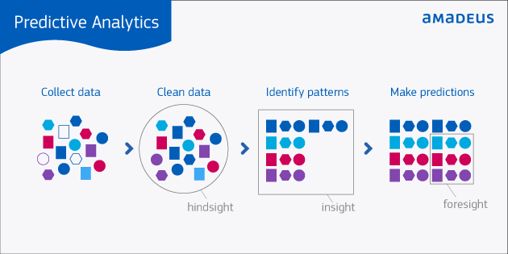
What is predictive analysis?

Slide 6
Problem Definition and Scope
To propose a Placement Prediction System which predicts the binary outcome of a undergrad student getting placed in a company by applying the machine learning algorithms like K-Nearest Neighbours, Logistic Regression , Random Forest and Support Vector Machines where we compare the efficiency of the same with the proposed model.
Presently, the scope of this model is limited to college placement activities and companies visiting a campus for recruitment. Further this system would also be beneficial to the companies for recruitment purposes.

Slide 7
Methodology
Data Collection
Parameters used
Proficiency Competency Analysis
Proposed Model

Slide 8
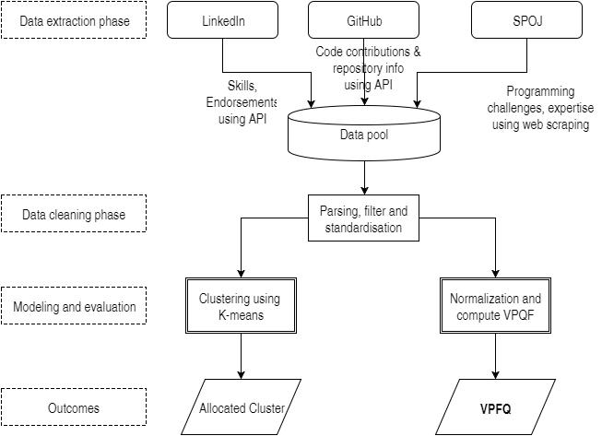
Proficiency Competency Analysis

Slide 9
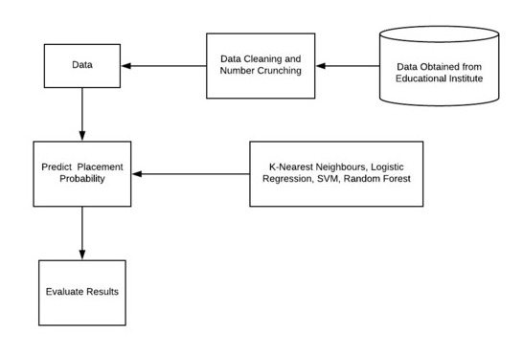
Proposed Model

Slide 10
Different Machine Learning Algorithms
K-Nearest Neighbours
Logistic Regression
Support Vector Machines
Random Forest

Slide 11

K-Nearest Neighbors (K-NN)
Supervised learning algorithm.
Non-Parametric classification algorithm.
Instance based or lazy learner.

Slide 12
Making prediction using K-NN
Determine the value of k.
Compute the distance between each record of the training set and the testing record.
Sort the neighbors in the increasing order of the distances.
Select the first k neighbors from the sorted list.
Check for the class, that majority of the neighbors belong to and assign that class to the training data.

Slide 13
Proximity Metrics:
Euclidean Distance.
Humming Distance.
Manhattan Distance.
Minkowsky.
Chebychev Distance.

Slide 14
Mathematical Instances:
Euclidean Distance: Most Commonly used for K-NN
Euclidean distance is calculated as the square root of the sum of the squared differences between a new point (x) and an existing point (xi) across all input attributes j.
EuclideanDistance(x, xi) d = sqrt( sum( ( xj – xj )^2 ) )
Weight is calculated as 1/(d^2).
Lower the distance between two points in space, higher is the proximity measure.

Slide 15
Advantages:
Why K-NN ?
Simplest among all machine learning algorithms.
Robust to noisy training data.
Effective if training data is large.
No training phase.
Learns complex models easily.
Highest prediction power.

Slide 16
Disadvantages:
Why not to use K-NN ?
Need to determine “K”.
Not clear which distance metric to be used.
Computational cost is high.
Prediction stage might be slow.
Need large amount of samples for accuracy.

Slide 17
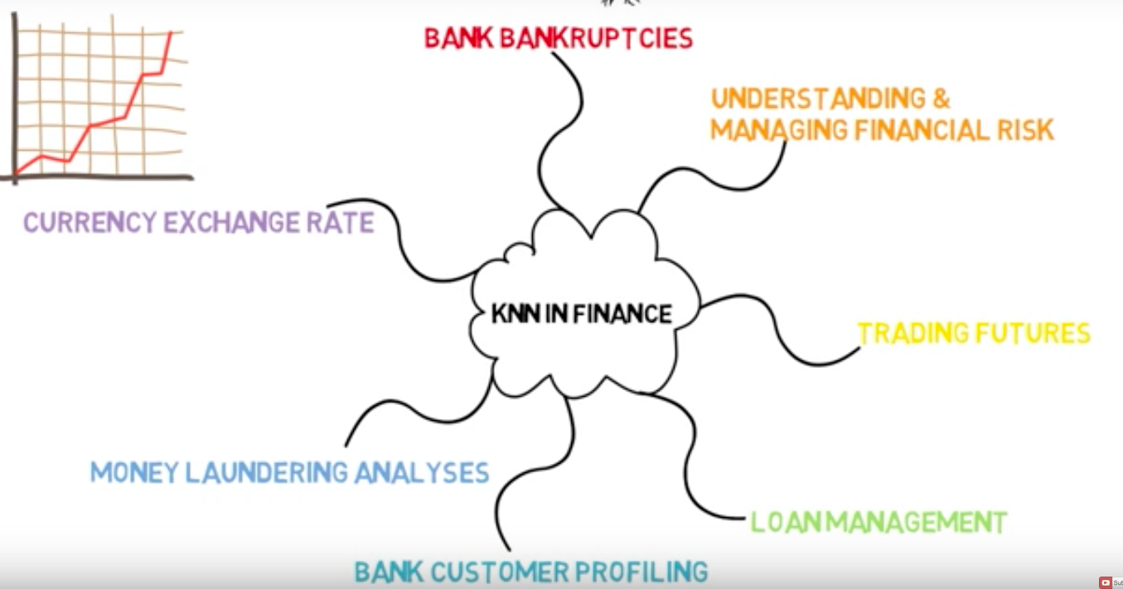
Applications:
Text Mining.
Text Categorisation.
Climate forecasting.
Estimating environmental parameters.
Stock market.

Slide 18
Different Machine Learning Algorithms
K-Nearest Neighbours
Logistic Regression
Support Vector Machines
Random Forest

Slide 19
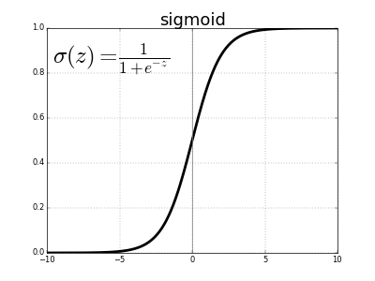
Logistic Regression
Supervised Learning Algorithm
Statistical Method for analysing a dataset
Dichotomous Outcome

Slide 20
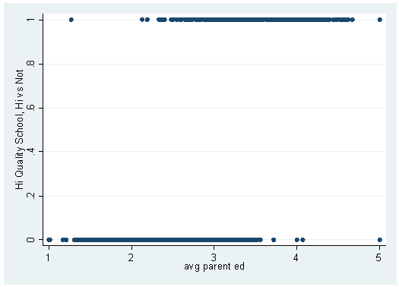
When to use Logistic Regression?
Scatter Plot

Slide 21

Mathematical Equations
Value of prediction (z): z = Ѳ^{T} x
sigmoid(x) = 1 / (1+ e^{(-x)})
Hypothesis of logistic classifier: h_{Ѳ}(x) = 1/ (1+ e^{-z})
Cost Function: J(Ѳ) = (1/m)[∑^{m}_{i=1} y^{(i)}log(h_{Ѳ}(x^{(i)}))+(1-y^{(i)})log(1-h_{Ѳ}(x^{(i)}))]
Gradient Descent Algorithm: [Ѳ_{j} := Ѳ_{j} - A(1/m)∑^{m}_{i=1}(h_{Ѳ}(x^{(i)})-y^{(i)})x_{j}^{(i)}]

Slide 22
Advantages
Works well with diagonal decision boundaries
Does not give undue weight to correlated features
Probabilistic outcome

Slide 23
Disadvantages
Requires large data set for stable outcomes
Complex than linear regression

Slide 24
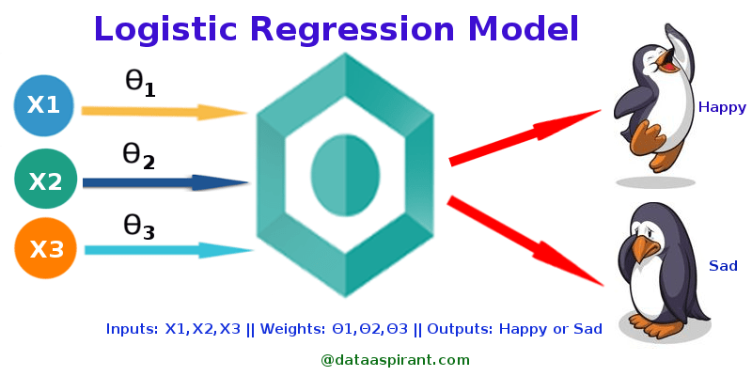
Applications
Image Segmentation and Categorization
Geographic Image Processing
Handwriting recognition
Healthcare
Predictive analysis

Slide 25
Different Machine Learning Algorithms
K-Nearest Neighbours
Logistic Regression
Support Vector Machines
Random Forest

Slide 26
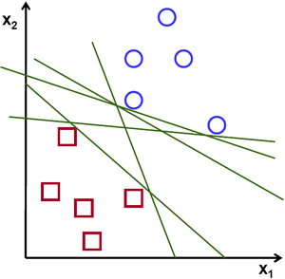
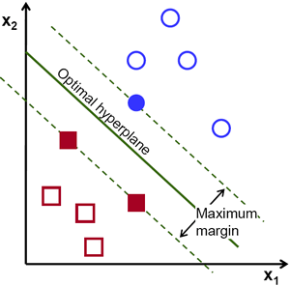
Support Vector Machines
What is SVM?

Slide 27
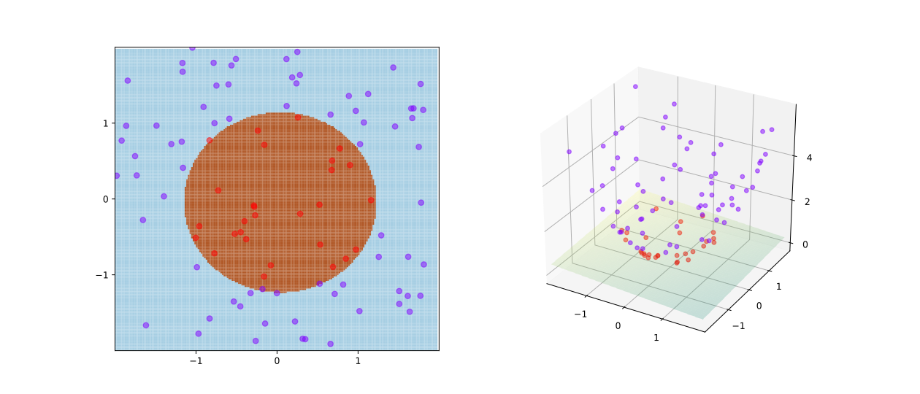
Kernel Trick in SVM
Fig:A training example of SVM with kernel given by φ((a, b)) = (a, b, a² + b²)

Slide 28
SVM : Pros and Cons
PROS :
SVM is a kernel-based algorithm.
Good at dealing with high dimensional data.
Works well on small data sets.
CONS :
Picking the right kernel and parameters can be computationally intensive

Slide 29
Different Machine Learning Algorithms
K-Nearest Neighbours
Logistic Regression
Support Vector Machines
Random Forest

Slide 30

Random Forest
A classifier as well as regressor.
Based on decision trees.
Developed by L. Breiman in 2001.
Type to enter a caption.

Slide 31
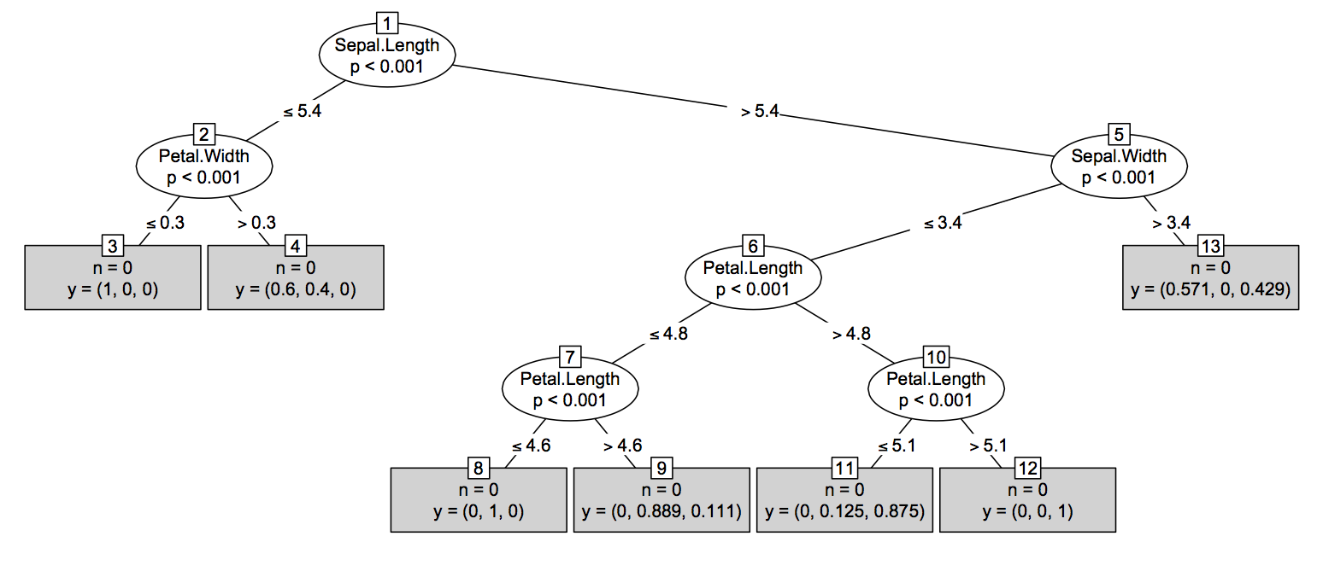
Visualisation of Random Forest
Fig. Leaf denoting the the outcomes of the given data

Slide 32
Algorithm: Random Forest
Assumption: Let ((x1, y1), (x2, y2), …(xn, yn)) be a set of points where each xi is m-dimensional (m-features) and yi denotes an outcome.
for b = 1 to B :
Draw a sample Z* of size N from the training data.
Grow a random forest tree Tb to the data processed, by recursively repeating the following steps for each terminal node till minimum is reached.
Select any t variables (1 <= t < n) from set of variables
Pick the best split variable among those m points.
Split the node into two.
Output the ensemble of tree Tb.

Slide 33
Random Forest: Advantages
It can handle certain populated and unbalanced data sets.
Generated forest can be further used on future data.
By averaging the results from several trees, it can also classify packed data and reduce overfitting.
It offers an experimental methods to detect variable interaction.
It computes proximities between pairs of cases that can be used in clustering, and gives view of data more compelling.

Slide 34
Random Forest: Disadvantages
The variable importance scores from random forest are not reliable.
Random forest are difficult to construct due to it’s complexity
The construction as well as the prediction process is time-consuming.

Slide 35
Implementation
Let’s have a look at the implementation….
OS: macOS High Sierra
Platform: Anaconda-navigator: Spyder(3.2.6)
Dataset: Dummy dataset of placement records

Slide 36
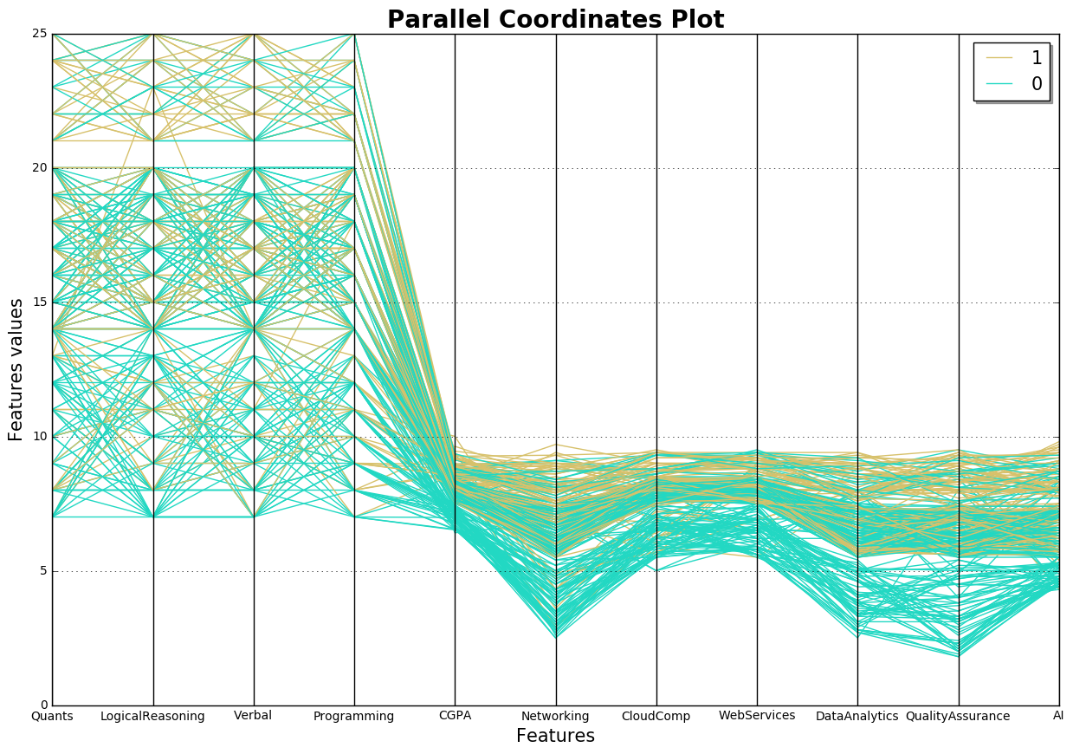
Dataset Coordinate Plots

Slide 37
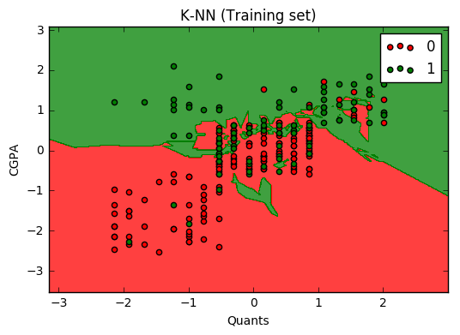
Training Set: K-NN

Slide 38
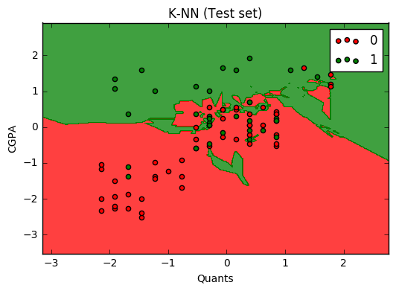
Test Set : K-NN

Slide 39
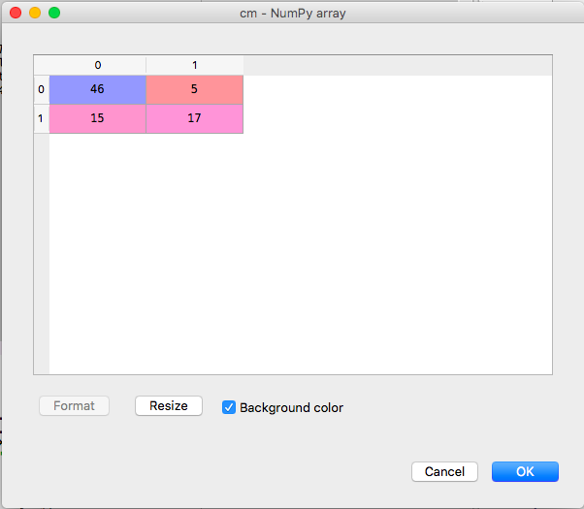
Confusion Matrix : K-NN
 | PREDICTED
A C T U A L |  | Placed | Not Placed
 | Placed | 46 | 5
 | Not Placed | 15 | 17
 | Accuracy 75.90%

Slide 40
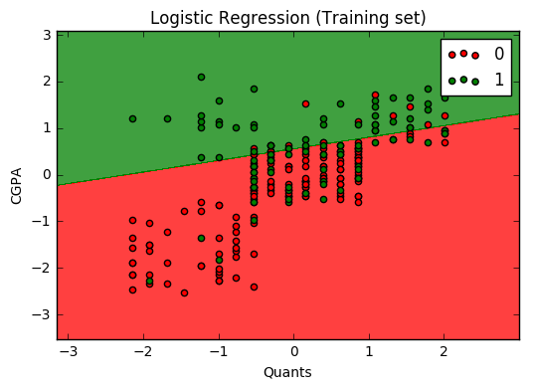
Training Set: Logistic Regression

Slide 41
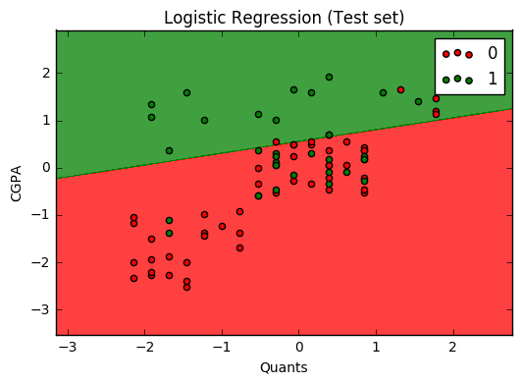
Test Set : Logistic Regression

Slide 42
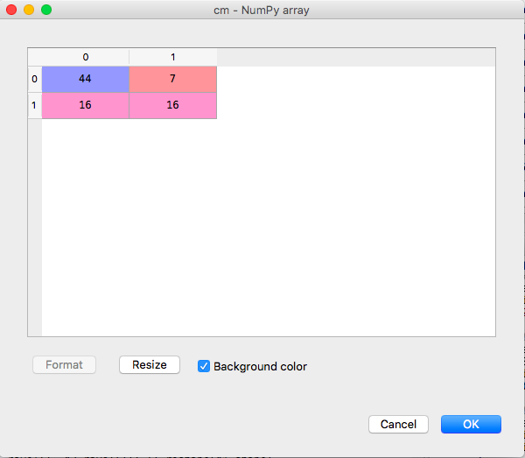
Confusion Matrix : Logistic Regression
 | PREDICTED
A C T U A L |  | Placed | Not Placed
 | Placed | 44 | 7
 | Not Placed | 16 | 16
 | Accuracy 72.28%

Slide 43
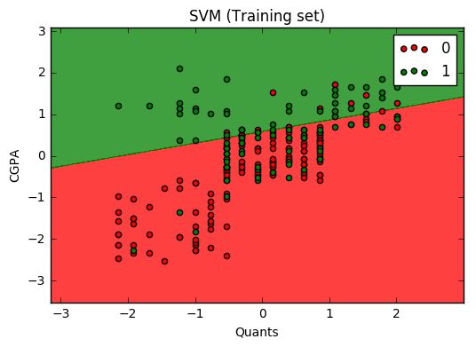
Training Set: SVM

Slide 44
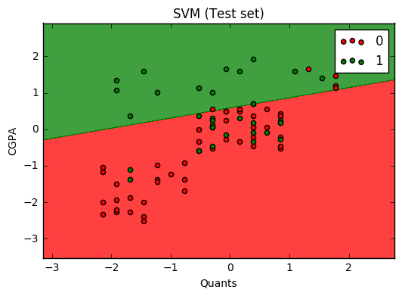
Test Set : SVM

Slide 45
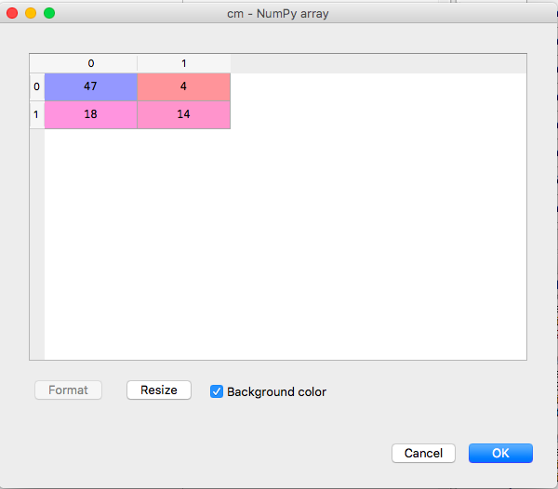
Confusion Matrix : SVM
 | PREDICTED
A C T U A L |  | Placed | Not Placed
 | Placed | 47 | 4
 | Not Placed | 18 | 14
 | Accuracy 73.49%

Slide 46
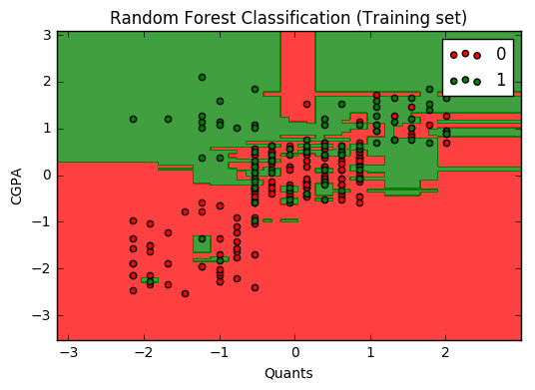
Training Set: Random Forest

Slide 47
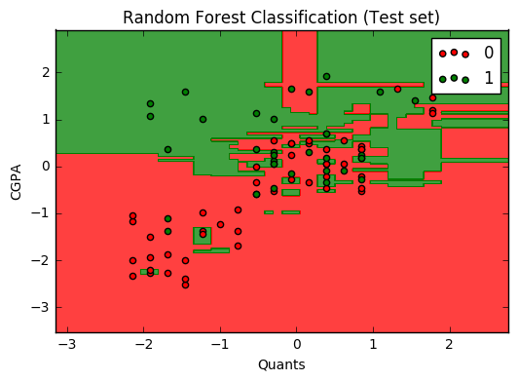
Test Set : Random Forest

Slide 48
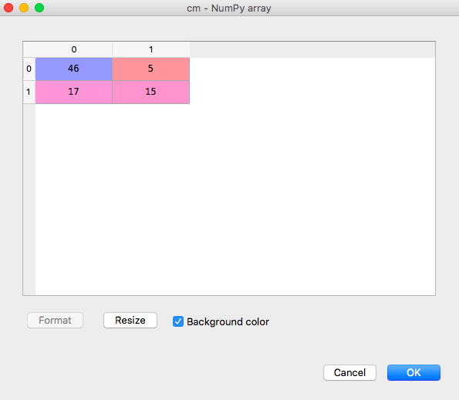
Confusion Matrix : Random Forest
 | PREDICTED
A C T U A L |  | Placed | Not Placed
 | Placed | 46 | 5
 | Not Placed | 17 | 15
 | Accuracy 73.49%

Slide 49
Results
Comparison table:
ALGORITHM | ACCURACY
K-NN | 75.90%
LOGISTIC REGRESSION | 72.28%
SVM | 73.49%
RANDOM FOREST | 73.49%

Slide 50
Conclusion
The results we obtained from different machine-learning algorithms were found to have minimal difference which varies from 0% to 3%.
Hence we conclude that the proposed Placement Prediction System produces a fair outcome with pretty good accuracy.
Thus, predicting the placement of the student gives the idea to the placement office as well as the students on where they stand.
The key lies in assessing the capabilities of the student in the right areas and subjecting them to the right training.

Slide 51
References
Animesh Giri, “VRITTHI A Theoretical Framework for IT recruitment based on Machine Learning techniques applied over Twitter, LinkedIn, SPOJ and GitHub profiles, IEEE 2016”
Ajay Shiv Sharma, “PPS - Placement Prediction System using Logistic Regression, IEEE 2014”
Ch.Sai Sindhu, “Predictive Analysis using SVM,International Journal for Modern Trends in Science and Technology, IEEE 2017”
Zhen Hu, “Stock Market Prediction using SVM, International Conference on Information Management, Innovation Management and Industrial Engineering, IEEE 2013”
Dragutin Petkovic, “Using Random Forest Classifier to Assess and Predict Student Learning of Software Engineering Team Work, IEEE 2016”
https://docs.opencv.org/2.4/modules/ml/doc/k nearest neighbors.html
https://web.stanford.edu/class/archive/cs/cs109/cs109.1176/lectureHandouts/23 Logistic Regression.pdf
https://www.medcalc.org/manual/logistic_regression.php
https://docs.opencv.org/2.4/doc/tutorials/ml/introduction to svm/introduction to svm.html
https://docs.opencv.org/2.4/modules/ml/doc/random_trees.html
Python 2.7.x/3.5.x Documentation -docs.python.org/
Scikit-learn Machine Learning in Python -www.scikit-learn.org

Slide 52
THANK YOU

